Slide 1

spring framework
Let's build a better Enterprise.

Slide 2
spring framework
introduction
Spring helps development teams everywhere build simple, portable, fast and flexible JVM-based systems and applications.
From configuration to security, web apps to big data – whatever the infrastructure needs of your application may be, there is a Spring Project to help you build it. Start small and use just what you need – Spring is modular by design.
https://spring.io

Slide 3
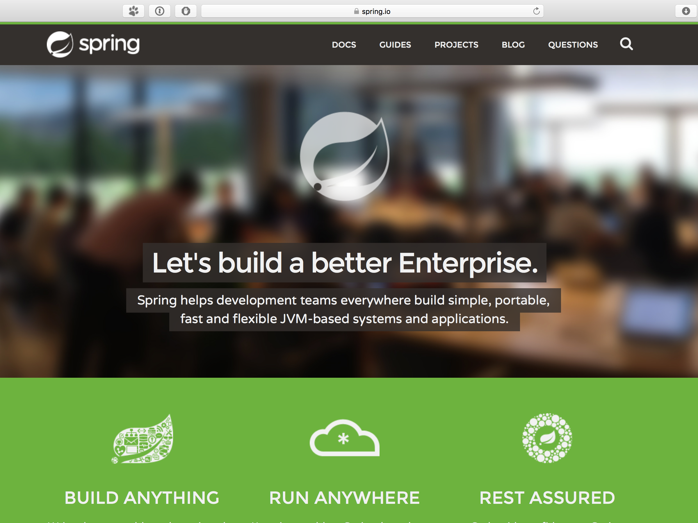

Slide 4
spring framework
introduction
Now it contains a lot of projects
Main projects (19)
Community projects (2)
In the Attic (3)
Also, it have fork for .NET platform
… but it’s all begun from small set of IoC (Inversion of Control), transaction management, MVC, AOP and etc.

Slide 5
spring io platform
main projects
Provides a cohesive, versioned platform for building modern applications. It is a modular, enterprise-grade distribution that delivers a curated set of dependencies.
The Spring IO platform includes Foundation Layer modules and Execution Layer domain-specific runtimes (DSRs). The Foundation layer represents the core Spring modules and associated third-party dependencies that have been harmonized to ensure a smooth development experience. The DSRs provided by the Spring IO Execution Layer dramatically simplify building production-ready, JVM-based workloads.
The first release of Spring IO includes two DSRs: Spring Boot and Grails.
http://platform.spring.io/platform/
Features:
One platform, many workloads - build web, integration, batch, reactive and big data applications
Radically simplified development experience with Spring Boot
Production-ready features provided out of the box
Curated and harmonized dependencies that just work together
Modular platform that allows developers to deploy only the parts they need
Support for embedded runtimes, classic application server, and PaaS deployments
Depends only on Java SE, and supports Groovy, Grails and some Java EE
Works with your existing dependency management tools such as Maven and Gradle
The Spring IO Platform is certified to work on JDK 7 and 8

Slide 6
spring boot
main projects
Takes an opinionated view of building Spring applications and gets you up and running as quickly as possible.
Spring Boot makes it easy to create stand-alone, production-grade Spring based Applications that you can «just run». We take an opinionated view of the Spring platform and third-party libraries so you can get started with minimum fuss. Most Spring Boot applications need very little Spring configuration.
http://projects.spring.io/spring-boot/
Features:
Create stand-alone Spring applications
Embed Tomcat, Jetty or Undertow directly (no need to deploy WAR files)
Provide opinionated ‘starter’ POMs to simplify your maven configuration
Automatically configure Spring whenever possible
Provide production-ready features such as metrics, health checks and externalized configuration
Absolutely no code generation and no requirement for XML configuration

Slide 7
spring framework
main projects
Provides core support for dependency injection, transaction management, web apps, data access, messaging and more.
The Spring Framework provides a comprehensive programming and configuration model for modern Java-based enterprise applications - on any kind of deployment platform. A key element of Spring is infrastructural support at the application level: Spring focuses on the «plumbing» of enterprise applications so that teams can focus on application-level business logic, without unnecessary ties to specific deployment environments.
http://projects.spring.io/spring-framework/
Features:
Dependency injection
Aspect-Oriented Programming including Spring’s declarative transaction management
Spring MVC web application and RESTful web service framework
Foundational support JDBC, JPA, JMS
…and much more

Slide 8
spring framework
main projects

Slide 9
spring xd
main projects
Simplifies the development of big data applications by addressing ingestion, analytics, batch jobs and data export.
Spring XD is a unified, distributed, and extensible system for data ingestion, real time analytics, batch processing, and data export. The project goal is to simplify the development of big data applications.
http://projects.spring.io/spring-xd/
Benefits:
Unified Platform - Spring XD is a unified platform for a fragmented Hadoop ecosystem. It’s built on top of battle-tested open source projects, and dramatically simplifies orchestration of Big Data workloads and data pipelines.
Open and Extensible - Spring XD is built to be adapted from the ground up to suit your enterprise’s unique needs, not dictate your technology choices for you. Extend in any direction with open plug-in points for your existing technology investments, implemented with simple Java classes.
Developer Productivity - Developers new to Big Data can use a no-coding, configuration driven tool to develop Spring XD applications. Java developers can also easily extend the platform or the DSL with familiar extensibility, testing, and automation tools.

Slide 10
spring xd
main projects

Slide 11
spring cloud
main projects
Provides a set of tools for common patterns in distributed systems. Useful for building and deploying microservices.
Spring Cloud provides tools for developers to quickly build some of the common patterns in distributed systems (e.g. configuration management, service discovery, circuit breakers and etc.). Coordination of distributes systems leads to boiler plate patterns, and using Spring Cloud developers can quickly stand up services and applications that implement those patterns. They will work well in any distributed environment, including the developer’s own laptop, bare metal data centers, and managed platforms such as Cloud Foundry.
http://projects.spring.io/spring-cloud/
Features:
Distributes / versioned configuration
Service registration and discovery
Routing
Service-to-service calls
Load balancing
Circuit Breakers
Global locks
Leadership election and cluster state
Distributed messaging

Slide 12
spring data
main projects
Provides a consistent approach to data access - relational, non-relational, map-reduce, and beyond.
Spring Data’s mission is to provide a familiar and consistent, Spring-based programming model for data access while still retaining the special traits of the underlying data store.
It makes it easy to use data access technologies, relational and non-relational databases, map-reduce frameworks, and cloud-based data services. This is an umbrella project which contains many subproject that are specific to a given database. The projects are developed by working together with many of the companies and developers that are behind these exciting technologies.
http://projects.spring.io/spring-data/
Features:
Powerful repository and custom object-mapping abstractions
Dynamic query derivation from repository method names
Implementation domain base classes providing basic properties
Support for transparent auditing (created, last changed)
Possibility to integrate custom repository code
Easy Spring integration via JavaConfig and custom XML namespaces
Advanced integration with Spring MVC controllers
Experimental support for cross-store persistence

Slide 13
spring integration
main projects
Supports the well-known Enterprise Integration Patterns via lightweight messaging and declarative adapters.
Spring Integration provides a wide selection of a channel adapters and gateways to communicate with external systems. Channel Adapters are used for one-way integration (send or receive); gateways are used for request/reply scenarios (inbound and outbound).
http://projects.spring.io/spring-integration/
Features:
Implementation of most of the Enterprise Integration Patterns
Integration with External Systems
The framework has extensive JMX support

Slide 14
spring batch
main projects
Simplifies and optimizes the work of processing high-volume batch operations.
Spring Batch provides reusable functions that are essential in processing large volumes of records, including logging / tracing, transaction management, job processing statistics, job restart, skip, and resource management. It also provides more advanced technical services and features that will enable extremely high-volume and high performance batch jobs through optimization and partitioning techniques. Simple as well complex, high-volume batch jobs can leverage the framework in a highly scalable manner to process significant volumes of information.
http://projects.spring.io/spring-batch/
Features:
Transaction management
Chunk based processing
Declarative I/O
Start/Stop/Restart
Retry/Skip
Web based administration interface (Spring Batch Admin)

Slide 15
spring security
main projects
Protects your application with comprehensive and extensible authentication and authorization support.
Spring Security is a framework that focuses on providing both authentication and authorization to Java application. Like all Spring projects, the real power of Spring Security is found in how easily it can be extended to meet requirements.
http://projects.spring.io/spring-security/
Features:
Comprehensive and extensible support for both Authentication and Authorization
Protection agains attacks like session fixation, clickjacking, cross site request forgery, etc.
Servlet API integration
Optional integration with Spring Web MVC
Much more…

Slide 16
spring hatEOAs
main projects
Simplifies creating REST representations that follow the HATEOAS principle.
Spring HATEOAS provides some APIs to ease creating REST representation that follow the HATEOAS principle when working with Spring and especially Spring MVC. The core problem it tries to address is link creation and representation assembly.
http://projects.spring.io/spring-hateoas/
Features:
Model classes for link, resource representation models
Link builder API to create links pointing to Spring MVC controller methods
Support for hypermedia formats like HAL

Slide 17
spring social
main projects
Easily connects your applications with third-party APIs such as Facebook, Twitter, LinkedIn and more.
http://projects.spring.io/spring-social/
Consist of few projects:
Main projects:
Spring Social Core - a framework for creating connections between a Spring application and an API. Also includes support for «Sign in With [Provider]» for authenticating via an API provider.
Spring Social Facebook - a provider extension for Spring Social to enable connectivity with Facebook and an API binding for Facebook’s Graph API.
Spring Social Twitter - provider extension for Spring Social to enable connectivity with Twitter and an API binding for Twitter’s REST API.
Spring Social LinkedIn - a provider extension for Spring Social to enable connectivity with LinkedIn and an API binding for LinkedIn’s REST API.
Incubator projects:
Spring Social Github
Spring Social Tript

Slide 18
spring amqp
main projects
Applies core Spring concepts to the development of AMQP-based messaging solutions.
The Spring AMQP project applies core Spring concepts to the development of AMQP-based messaging solutions. It provides a «template» as a high-level attraction for sending and receiving messages. It also provides support for Message-driven POJOs with a «listener container». These libraries facilitate management of AMQP resources while promoting the use of dependency injection and declarative configuration. In all of these cases, you will see similarities to the JMS support in the Spring Framework.
http://projects.spring.io/spring-amqp/
The project consists of two parts:
spring-amqp is the base abstraction
spring-rabbit is the RabbitMQ implementation
Features:
Listener container for asynchronous processing of inbound messages
RabbitTemplate for sending and receiving messages
RabbitAdmin for automatically declaring queues, exchanges and bindings

Slide 19
spring mobile
main projects
Simplifies the development of mobile web apps through device detection and progressive rendering options.
Spring Mobile is a framework that provides capabilities to detect the type of device making a request to your Spring web site and serve alternative views based on that device. Like all Spring projects, the real power of Spring Mobile is found in how easily it can be extended.
http://projects.spring.io/spring-mobile/
Features:
A device resolver abstraction for server-side detection of mobile and table devices
Site preference management that allows the user to indicate if he or she prefers a «normal», «mobile», or «tablet» experience
A site switcher capable of switching the user to the most appropriate site, either mobile, tablet, or normal, based on his or her device and optionally indicated site preference
Device aware view management for organizing and managing different views for specific devices

Slide 20
spring for android
main projects
Provides key Spring components for use in developing Android applications.
Spring for Android is a framework that is designed to provide components of the Spring family of projects for use in Android apps. Like all Spring projects, the real power of Spring for Android is found in how easily it can be extended.
http://projects.spring.io/spring-android/
Features:
A REST client for Android
Auth support for accessing secure APIs

Slide 21
spring web flow
main projects
Supports building web applications with controlled navigation such as checking in for a flight or applying for a loan.
The sweet spot for Spring Web Flow are stageful web applications with controlled navigation such as checking in for a flight, applying for a loan, shopping cart checkout, or even adding a confirmation step to a form. What these scenarios have in common is one or more of the following traits:
There is a clear start and an end point
The user must go through a set of screens in a specific order
The changes are not finalized until the last step
Once complete it shouldn’t be possible to repeat a transaction accidentally
http://projects.spring.io/spring-webflow/
Spring Web Flow provides a declarative flow definition language for authoring flows on a higher level of abstraction. It allows it to be integrated into a wide range of applications without any changes (to the flow programming model) including Spring MVC, JSF, and even Portlet web applications. The following are common issues observed in stateful web applications with navigation requirements:
Visualizing the flow is very difficult
The application has a lot of code accessing the HTTP session
Enforcing controlled navigation is important but not possible
Proper browser back button support seems unattainable
Browser and server get out of sync with «Back» button use
Multiple browser tabs causes concurrency issues with HTTP session data
Spring Web Flow provides a solution to the above issues.

Slide 22
spring web services
main projects
Facilitates the development of contract-first SOAP web services.
Spring Web Services (Spring-WS) is a product of the Spring community focused on creating document-driven Web services. Spring Web Services aims to facilitate contract-first SOAP service development, allowing for the creation of flexible web services using one of the many ways to manipulate XML payloads. The product is based on Spring itself, which means you can use the Spring concepts such as dependency injection as an integral part of your Web service.
http://projects.spring.io/spring-ws/
People use Spring-WS for many reasons, but most are drawn to it after finding alternative SOAP stacks lacking when it comes to following Web service best practices. Spring-WS makes the best practice an easy practice. This includes practices such as the WS-I basic profile, Contract-First development, and having a loose coupling between contract and implementation.

Slide 23
spring web services
main projects
Makes the Best Practice an Easy Practice: Spring Web Services makes enforcing best practices easier. This includes practices such as the WS-I basic profile, Contract-First development, and having a loose coupling between contract and implementation.
Powerful mappings: You can distribute incoming XML request to any object, depending on message payload, SOAP Action header, or an XPath expression.
XML API support: Incoming XML messages can be handled in standard JAXP APIs such as DOM, SAX, and StAX, but also JDOM, dom4j, XOM, or even marshaling technologies.
Flexible XML Marshalling: The Object/XML Mapping module in the Spring Web Services distribution supports JAXB 1 and 2, Castor, XMLBeans, JiBX, and XStream. And because it is a separate module, you can use it in non-Web services code as well.
Support WS-Security: WS-Security allows you yo sign SOAP messages, encrypt and decrypt them, or authenticate against them
… and many more

Slide 24
spring ldap
main projects
Simplifies the development of applications using LDAP using Spring’s familiar template-based approach.
Spring LDAP is a Java library for simplifying LDAP operations, based on the pattern of Spring’s JdbcTemplate. The framework relieves the user of common chores, such as looking up and closing context, looping through results, encoding / decoding values and filters, and more.
http://projects.spring.io/spring-ldap/
Features:
Provides LDAP template which eliminates the need to worry about creating and closing LdapContext and looping through NamingEnumeration
Comprehensive unchecked Exception hierarchy built on Spring’s DataAccessException
Contains classes for dynamically building LDAP filters and Disingushed Names (DNs)
Client-side LDAP transaction management

Slide 25
spring session
main projects
Spring Session provides an API and implementations for managing a user’s session information.
http://projects.spring.io/spring-session/
Spring Session provides the following features:
API and implementations for managing a user’s session
HttpSession - allow replacing the HttpSession in an application container neutral way
Clustered Sessions - Spring Session makes it trivial to support clustered sessions without being tied to an application container specific solution
Multiple Browser Sessions - Spring Session supports managing multiple users’ sessions in a single browser interface
RESTful API - Spring Session allows providing session ids in header to work with RESTful APIs
WebSocket - provides the ability to keep the HttpSession alive when receiving WebSocket messages

Slide 26
spring shell
main projects
Provides a powerful foundation for building command-line apps using a Spring-based programming model.
Users of Spring Shell project can easily build a full featured shell (aka command line) application by depending on the Spring Shell jar and adding their own commands.
http://projects.spring.io/spring-shell/
Spring Shell’s features includes:
A simple, annotation driven, programming model to contribute custom commands
Use of Spring’s classpath scanning functionality as the basis for command plugin strategy and command development
Tab completion, colorization, and script execution
Customization of command prompt, banner, shell history file name
Dynamic enablement of commands based on domain specific criteria
Already built-in commands, such as clear screen, help, exit, etc.

Slide 27
spring shell
main projects
shell:>translate "hello world!" --from en_US --to fr_FR
bonjour monde!

Slide 28
spring shell
main projects
package foo;
import foo;
@CommandMarker
public class TranslationCommands {
private final TranslationService service;
@Autowired
public TranslationCommands(TranslationService service) {
this.service = service;
}
@CliCommand(value = "translate", help = "translate text from one language to another")
public String translate(@CliOption(key = {"", "text"}) String text,
@CliOption(key = "from", unspecifiedDefaultValue = "en_US") Locale from,
@CliOption(key = "to") Locate to
) {
return service.translate(text, from, to);
}
}

Slide 29
spring roo
community projects
Makes it fast and easy to build full Java applications in minutes. Is a lightweight developer tool that makes it fast and easy to deliver instant results. Best of all, you code 100% in Java and get reuse all your existing Java knowledge, skills and experience.
Technical reference can be found here: http://docs.spring.io/spring-roo/docs/current/reference/pdf/spring-roo-docs.pdf
http://projects.spring.io/spring-roo
Spring Roo differs from other productivity by focusing on:
Rapid results
100% develop in Java
Easy-to-use
Fast and simple to remove
Totally compromise free
Active, helpful community
Comprehensive technology integrations
Extension points via Roo add-ons
Spring-certified architecture

Slide 30
spring scala
community projects
Brings the power and expressiveness of Scala together with the productivity and deep ecosystem of Spring.
The goal of Spring Scala is to make it easier to use Spring framework in Scala. Spring Scala…
… allows wiring up Scala classes as Spring Beans
… provides Scala-friendly wrappers for the Spring templates
http://hub.darcs.net/psnively/spring-scala

Slide 31
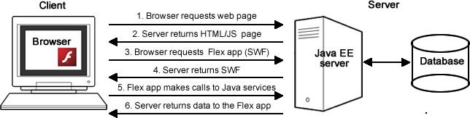
spring blazeds integration
projects in the attic
Provides first-class support for using Adobe BlazeDS in Spring-based apps with Adobe Flex front-end clients.
Can be easily configured by adding special servlet to application’s settings
Supports working with Hibernate entities on client side
Supports configuration of Spring Security
Technical reference can be found here: http://docs.spring.io/spring-flex/docs/1.5.x/reference/html/
https://github.com/spring-projects/spring-flex

Slide 32
spring loaded
projects in the attic
Boosts development productivity by reloading class file changes - as you make them - within your app’s JVM.
‘Hot code replace’ have set of limitations that are absent in Spring Loaded (for example: changes in methods’ signatures, constructors can be added in Spring Loaded and can NOT be added through ‘hot code replace’)
https://github.com/spring-projects/spring-loaded

Slide 33
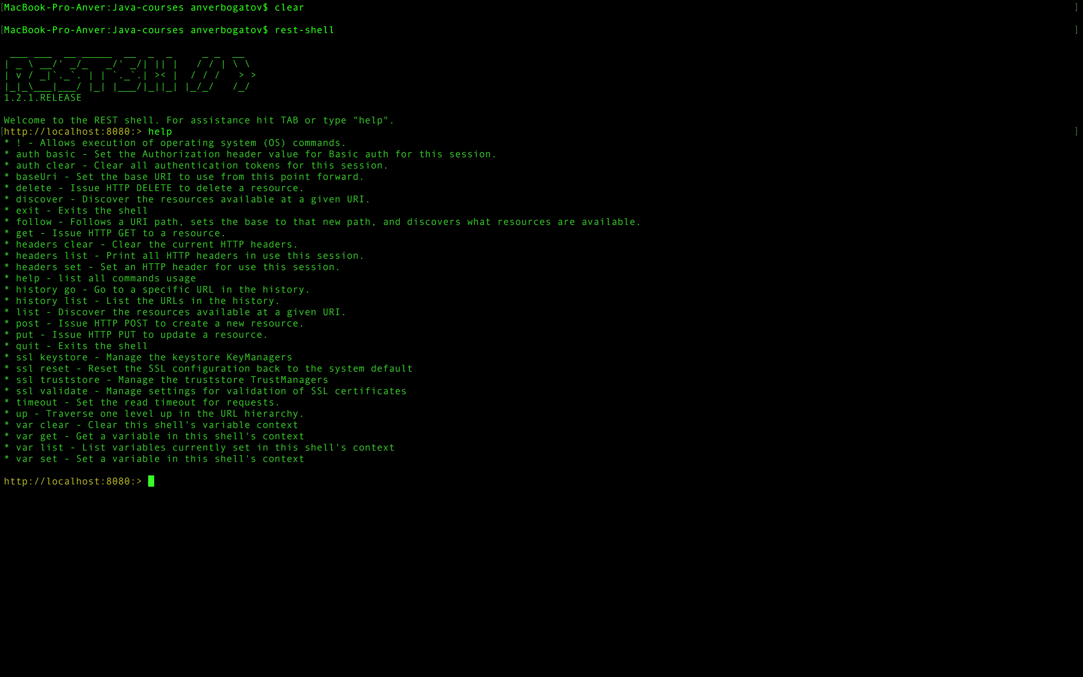
rest shell
projects in the attic
Makes writing and testing RESTful applications easier with CLI-based resource discovery and interaction.
https://spring.io https://github.com/spring-projects/rest-shell

